Slide 1
Swapping Cutters

Slide 2
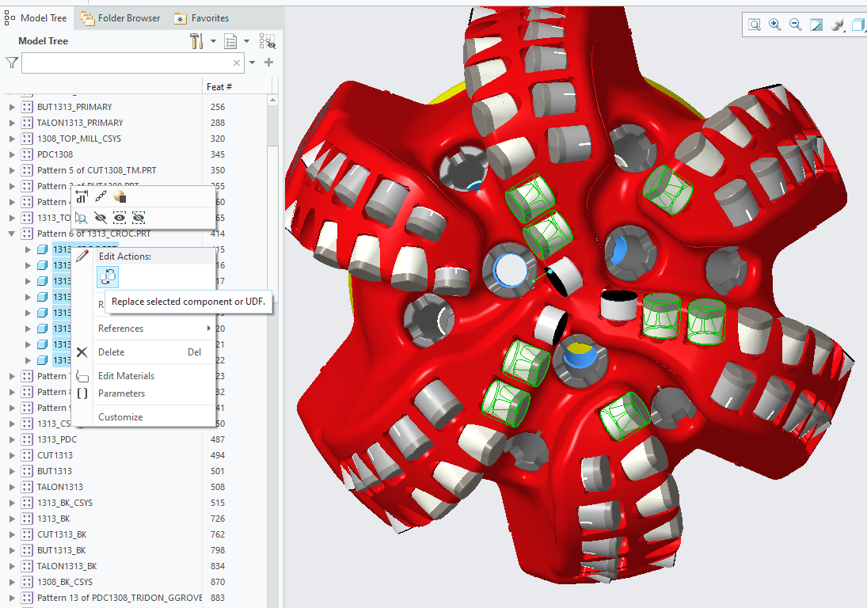
Swapping Cutters in Creo
Select cutter to be swapped
Select parent in cutter group in Model Tree
Right click > Edit Actions > Replace selected component or UDF
Be sure to separate pads if grouped to ensure pads are assigned unique names
Open gauge pad surface group
Copy-paste (ctrl+c, ctrl+v) surface group
Options > "Exclude surfaces and Fill holes"
Using Ctrl+left click select surfaces elements to be deleted
Repeat until each pad is its own unique surface group

Slide 3
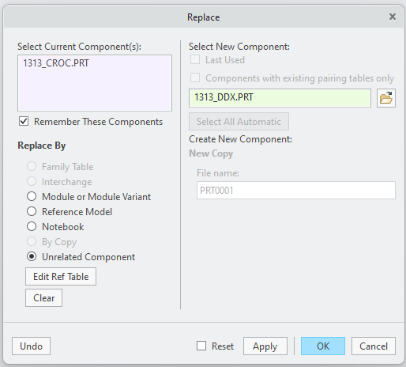
Swapping Cutters in Creo
Check Unrelated Component
Under Select New Component, open the explorer and navigate to replacement cutter
Click Ok
Click Yes on pop-up

Slide 4
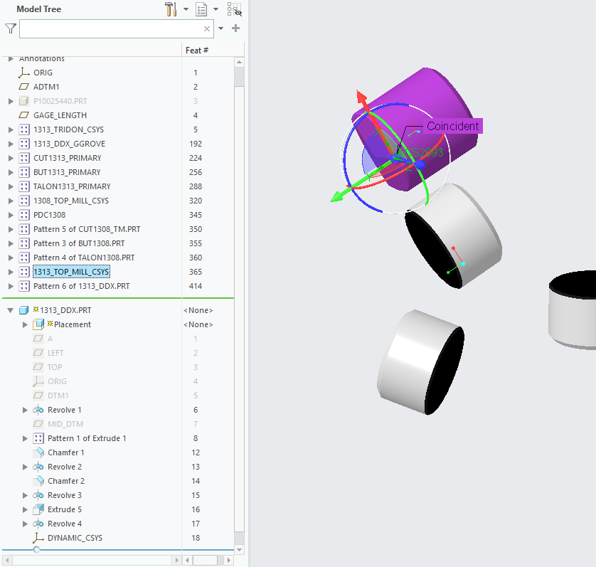
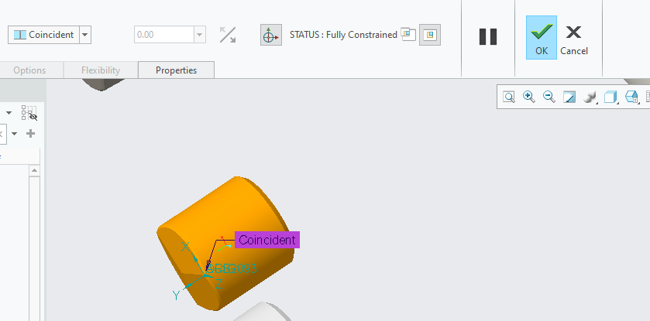
Swapping Cutters in Creo
Expand part section at bottom
Click on ORIG to align new part with old part (new part with turn orange)
Click OK at top ribbon
1
3
2

Slide 5
Last Slide

